Slide 1
Can Crime predict Deprivation?
Predicting the Index of Multiple Deprivation using police-recorded
crime data.

Slide 2
Contents
1.
Meet the team
2.
Problem statement
3.
Data sources
4.
Methodology
5.
Visualisations
6.
Machine Learning
7.
Conclusions

Slide 3
Meet the team
Group 1
Jade McFarlane
Rebecca Parker
Hong Tu
Rebecca Swarbrick
Maeve Finneran
Kelly O’Keefe
Idil Abdulle

Slide 4
Group 1
Problem Statement -
What we’re trying to answer
“Investigate the relationship between recorded crime and deprivation”
“Explore whether broader wellbeing indicators show similar regional patterns”
“Build a model to estimate IMD between official releases”

Slide 5
Data Sources
Year/Quarter/Month
Police Recorded Crime Data (2024-2025)
English Indices of Multiple Deprivation (IMD 2025)
UK Measures of National Wellbeing
ONS LAD
ONS Mid‑Year Population Estimates

Slide 6
Methodology
Data Cleaning & Standardisation
Removed unnecessary columns, handled missing values and standardised formats.
Standardised ITL1/ITL2 region names.
Created consistent geographic identifiers.
Data Integration
Merged datasets using LAD to ITL mappings.
Created a unified dataset for exploratory analysis and machine learning.
Data Collection
Collected official datasets from the Office for National Statistics (ONS) and UK Police.
Included crime, IMD, wellbeing, population, and geographic lookup datasets.
.

Slide 7
Methodology
Analytical Approach
Explored relationships between recorded crime, deprivation (IMD), and wellbeing indicators.
1
Exploratory Data Analysis
2
Visualisation
Produced visualisations to identify regional patterns, correlations, and outliers.
3
Machine Learning
Developed a Linear Regression model to predict IMD scores using recorded crime data.

Slide 8
Key Findings/
visualisations
How we’ll address or avoid challenges
Crime varies sharply across England
How we will address this:
Use ITL2 + LSOA levels to avoid misleading averages
Apply consistent LAD - ITL2 lookups
Break crime down by offence type for clearer patterns
Deprivation differs strongly between regions
How we will address this:
Analyse deprivation at multiple scales (ITL2 + LSOA)
Avoid relying on regional averages alone
Wellbeing data shows a limited link to crime
How we will address this:
Interpret wellbeing cautiously due to geographic mismatch
Use wellbeing as context, not direct comparison
Recommend consistent boundaries in future datasets

Slide 9
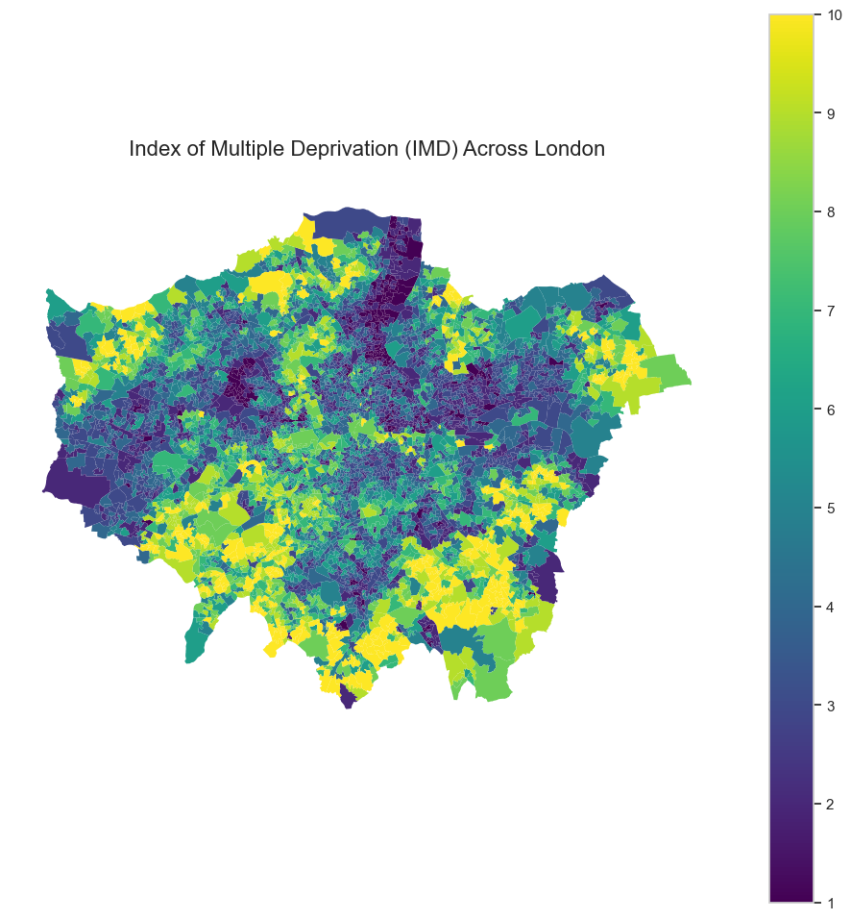
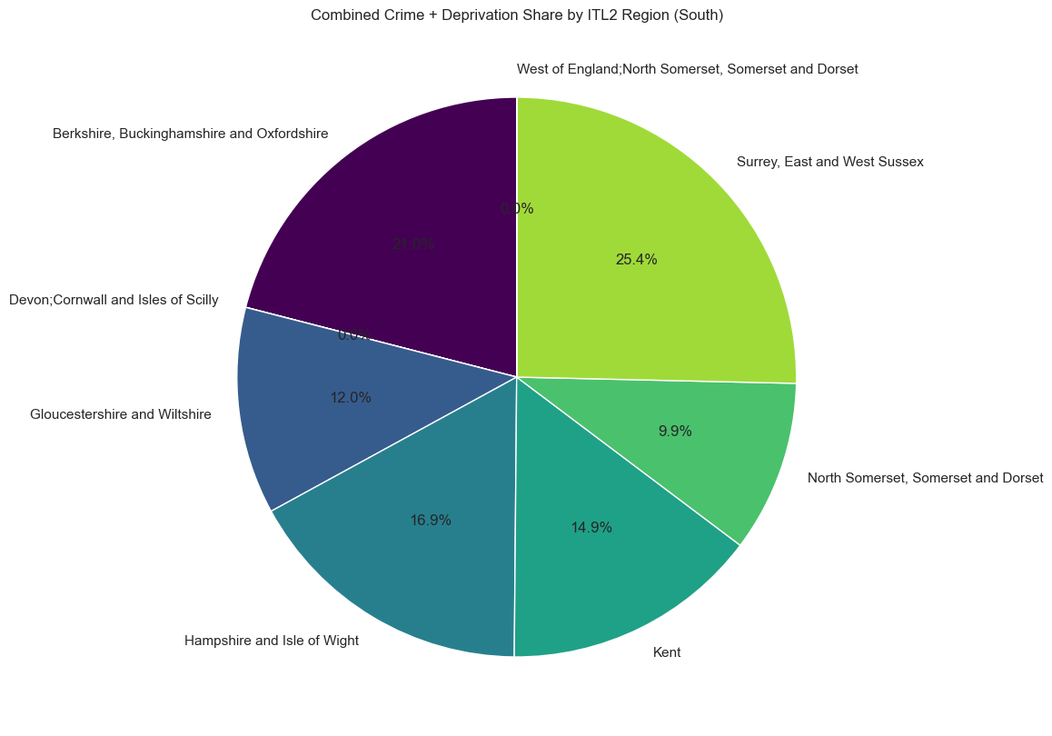
Visualisation

Slide 10
Key Findings
Communication objectives
Marketing objectives
Project outcomes
Actionable insights for local authorities
Identify high crime and high deprivation regions
HIghlight wellbeing indicators that add social context
Deliver a complete analytical project
Integrate three datasets successfully and analyse all three to compare
Produce clear visualisations
Document next steps and limitations
Clear explanation of crime–deprivation–wellbeing links
Use simple visuals and consistent terminology
Explain geographic limitations upfront
Present findings in clean, structured sections

Slide 11
Limitations & Recommendations
4
1
2
3
Write a few words about your communication goals for this project.
Recommendations
- Policymakers should consider neighbourhood-level variation when designing
interventions.
- Future government datasets would benefit from using more consistent
geographic boundaries to improve cross-dataset analysis.
- Future research could incorporate additional socioeconomic variables, such as employment, education or housing, to provide a more comprehensive
understanding of the factors associated with crime.
Limitation
Limitation
Limitation
- Geographic boundaries were not fully aligned across datasets.
- Crime data was only available at police force level rather than neighbourhood
level, limiting direct comparison with deprivation data.
- Deprivation data – measures relative deprivation rather than absolute
deprivation, and is at LSOA level.
- Wellbeing data – this was available at a broader regional level, limiting direct
comparison with the crime and deprivation datasets.

Slide 12
CONCLUSIONS
Year/Quarter/Month
This project investigated relationships between crime, deprivation and wellbeing across England using multiple publicly available datasets.
The analysis identified substantial variation in crime levels between regions and highlighted London’s distinctive crime profile. Deprivation analysis revealed substantial geographic variation across England.
1
2
Deprivation analysis revealed substantial geographic variation across England.
The London case study demonstrated that
regional averages can conceal significant neighbourhood-level variation, highlighting the
importance of analysing data at an appropriate geographic scale.
3
4
The London case study demonstrated that regional averages may mask significant neighbourhood-level
variation.

Slide 13
Any questions?
Ask away!

Slide 14
Thank you

